Slide 1
ME 233 Advance Control II
Lecture 9
Review of some topics for infinite-horizon control and estimation
(Not in the ME233 Class Notes)
TexPoint fonts used in EMF.
Read the TexPoint manual before you delete this box.: AAAAAAAAAAA

Slide 2
Outline
Controllability
Observability
Stabilizability
Detectability
Transmission Zeros

Slide 3
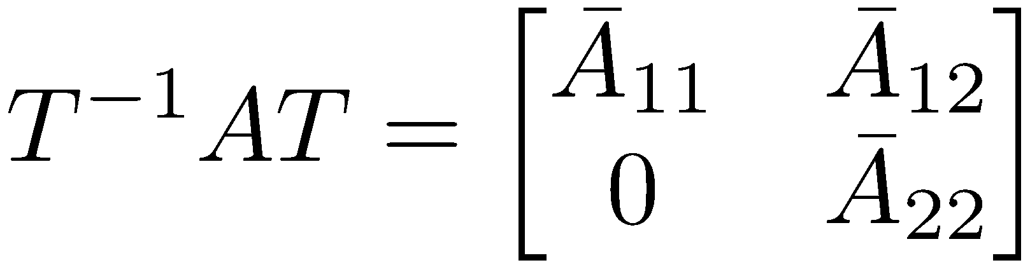
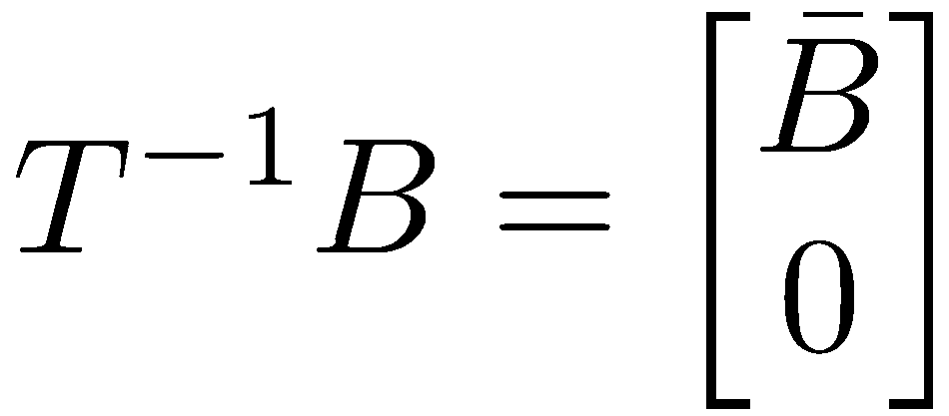
Controllability
Let
Theorem: The following are equivalent:
(A,B) is controllable
There does not exist T such that
The eigenvalues of A+BK can be arbitrarily assigned via choice of K

Slide 4
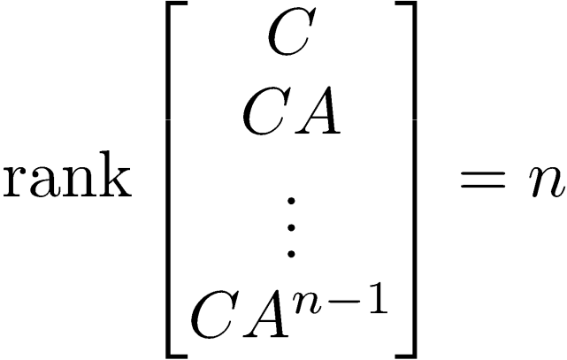
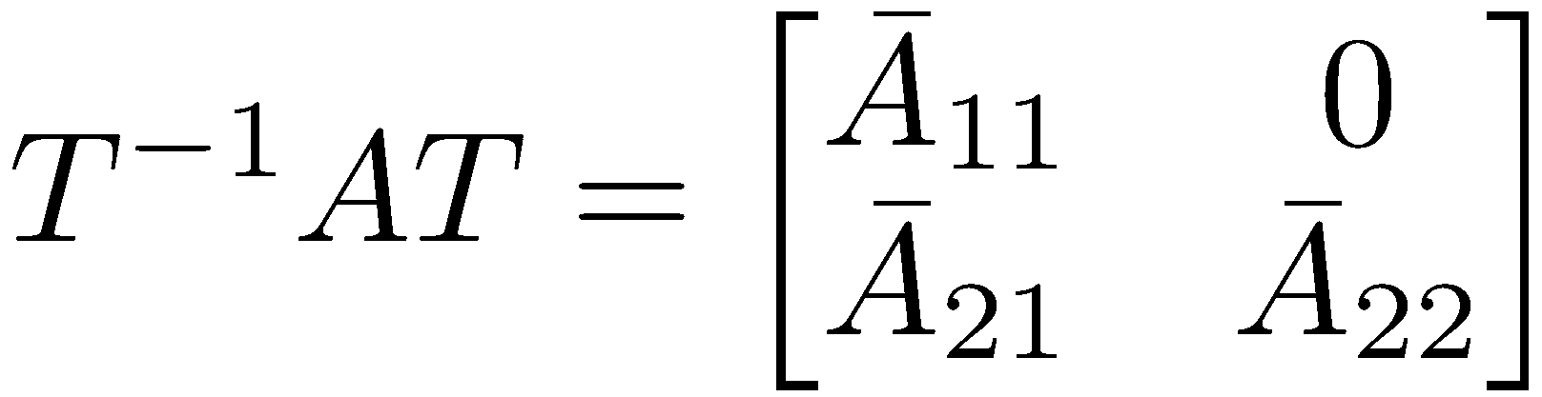

Observability
Let
Theorem: The following are equivalent:
(C,A) is observable
There does not exist T such that

Slide 5
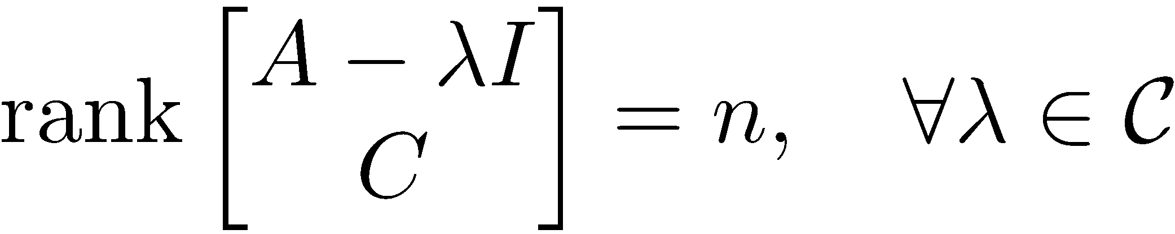
Observability
Let
Theorem (cont’d):
The eigenvalues of A+LC can be arbitrarily assigned via choice of L

Slide 6
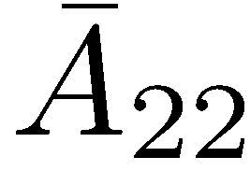


Stabilizability (discrete-time)
Let
Theorem: The following are equivalent:
(A,B) is stabilizable
There does not exist T such that
There exists K such that A+BK is Schur
where is not Schur
whenever

Slide 7
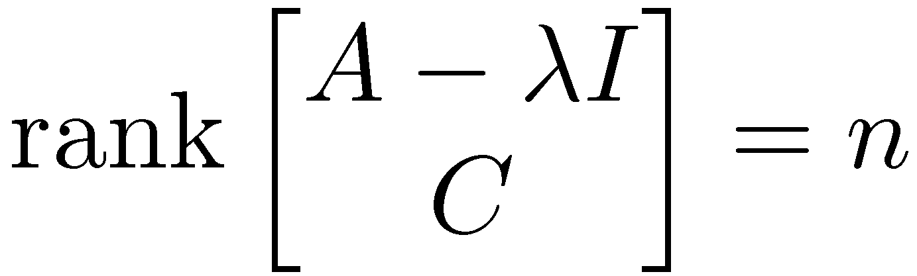
Detectability (discrete-time)
Let
Theorem: The following are equivalent:
(C,A) is detectable
There does not exist T such that
There exists L such that A+LC is Schur
where is not Schur
whenever

Slide 8









Proof of controllability theorem
see ME232 notes
We will show the contrapositive
  Choose such that
  Choose such that
is an eigenvalue of A+BK, regardless of K
The eigenvalues of A+BK can NOT be freely assigned by choice of K

Slide 9


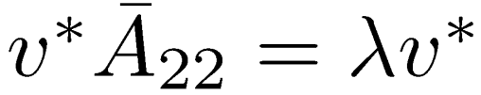
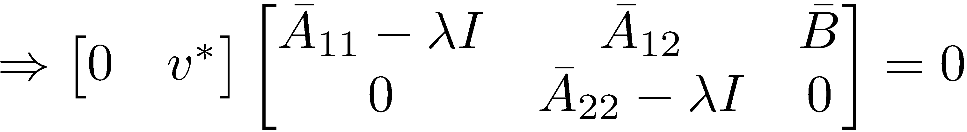
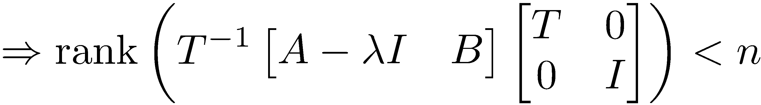
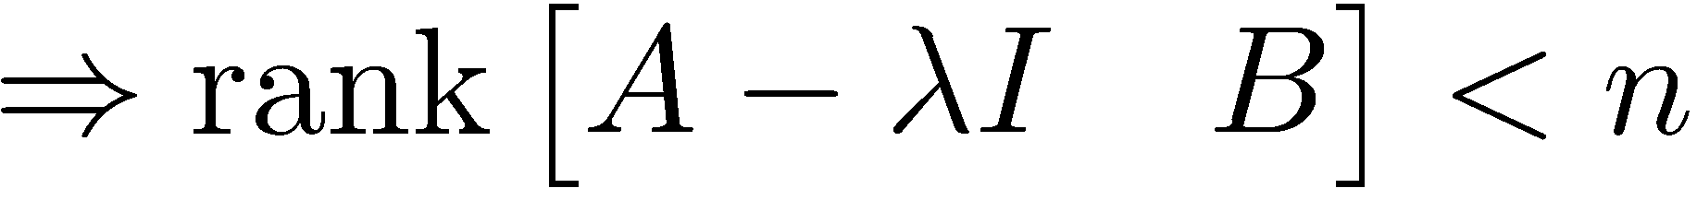
Proof of controllability theorem
We will show the contrapositive
  Choose T such that
  Choose such that

Slide 10
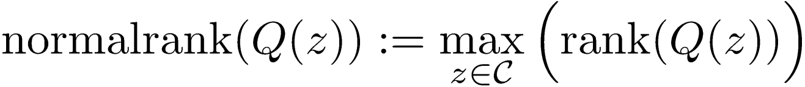
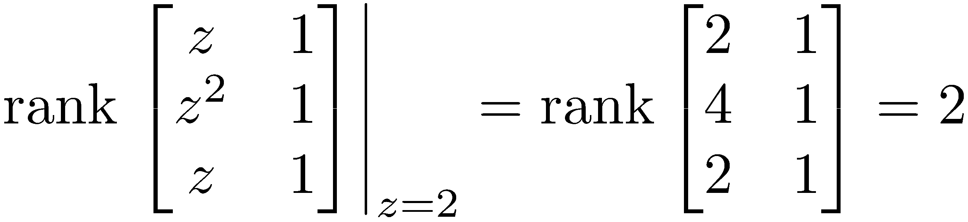
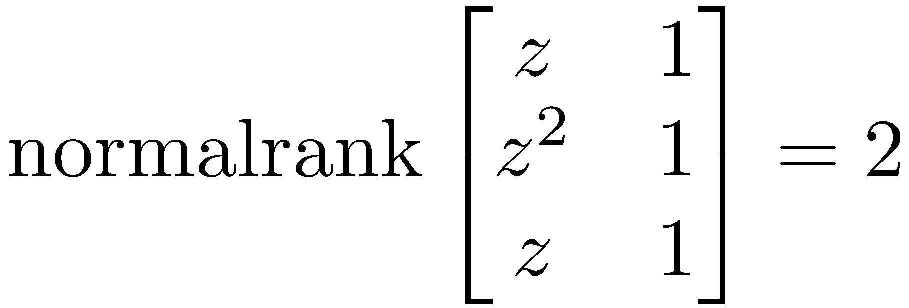

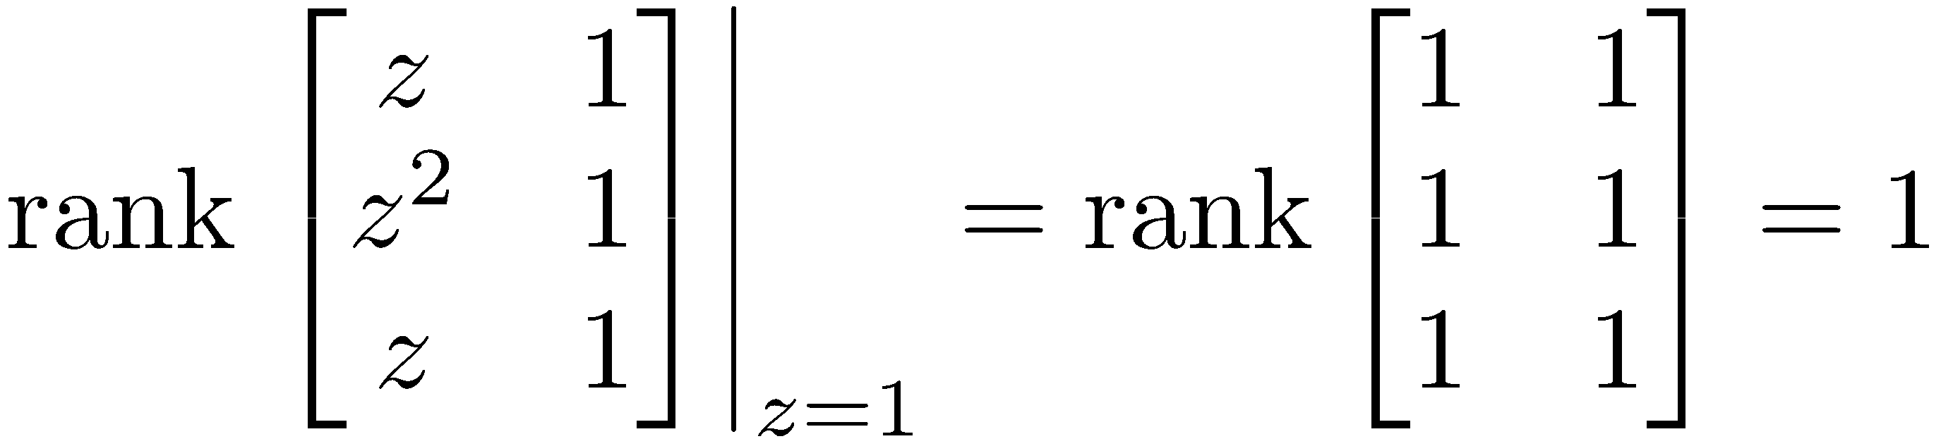
Normalrank of a
MIMO transfer function
Let Q(z) be a matrix transfer function
Define
Example:
even though

Slide 11


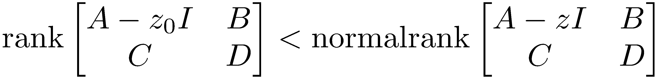
Transmission zeros
Let G(z) be a transfer function with the state-space realization
is called a transmission zero of this realization if
MATLAB command: zero(sys)

Slide 12
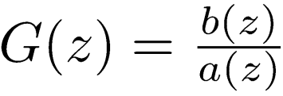
SISO transmission zeros
Suppose G(z)=C(zI-A)⁻¹B+D is a SISO transfer function that is not identically zero
Let where a(z) and b(z) are polynomials
Assume without loss of generality that a(z) = det(zI – A)

Slide 13
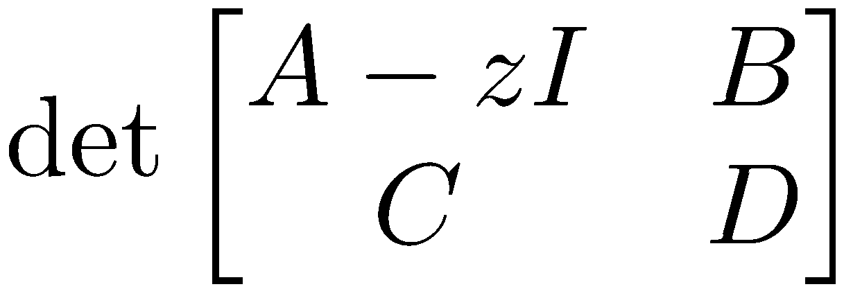

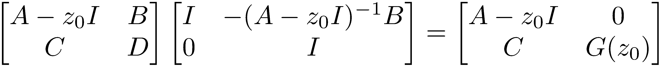
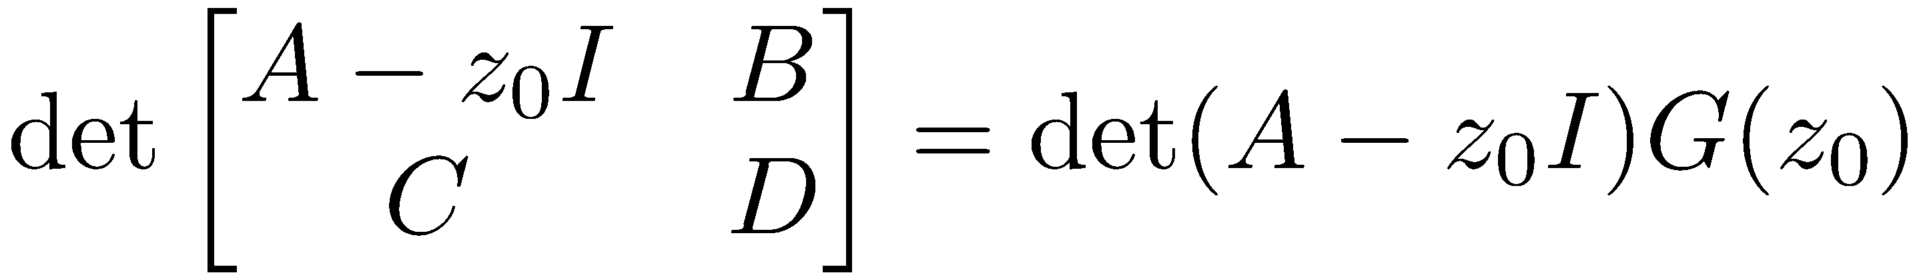
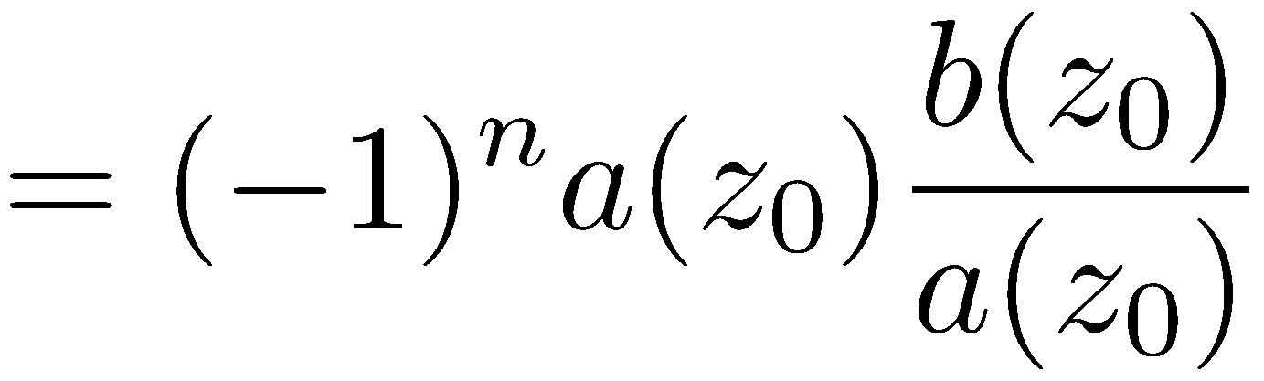
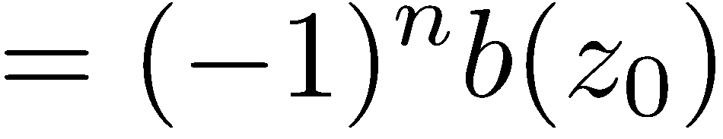
SISO transmission zeros
Note that is a polynomial in z
Choose z₀ such that
continuous function of z

Slide 14

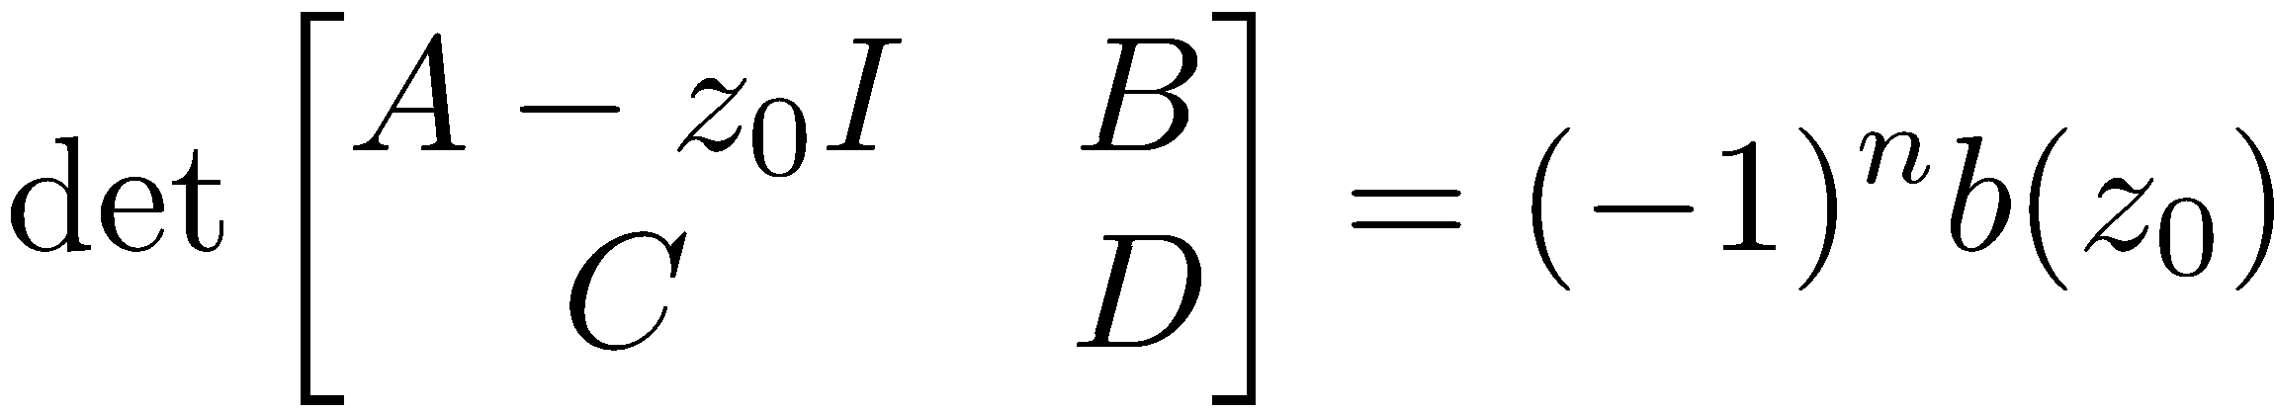
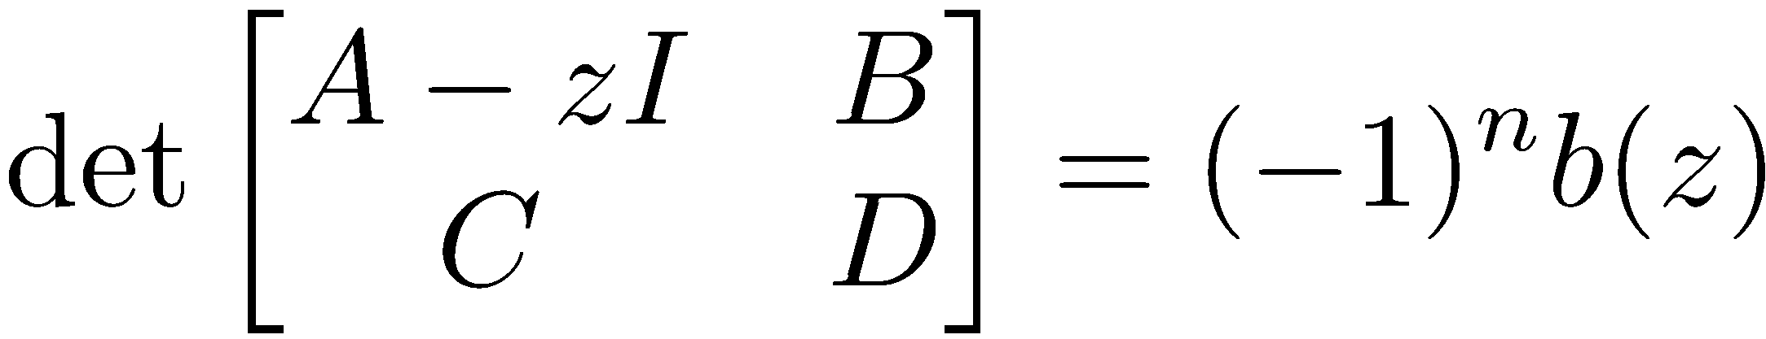
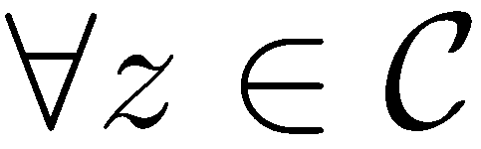
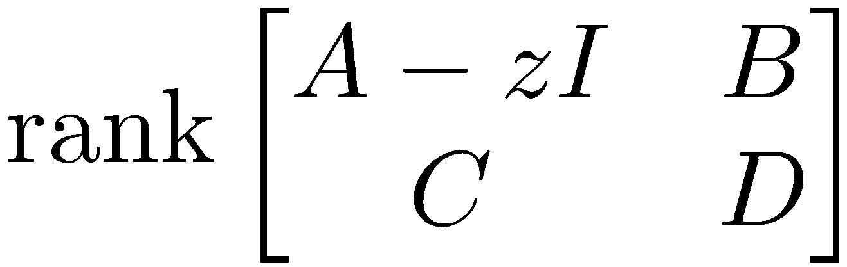
SISO transmission zeros
Numerator of G(z)
Whenever ,
By continuity of the left-hand side
Since b(z) is not identically 0, drops if and only if b(z)=0
z is a transmission zero if and only if it is a zero of the transfer function G(z)

Slide 15



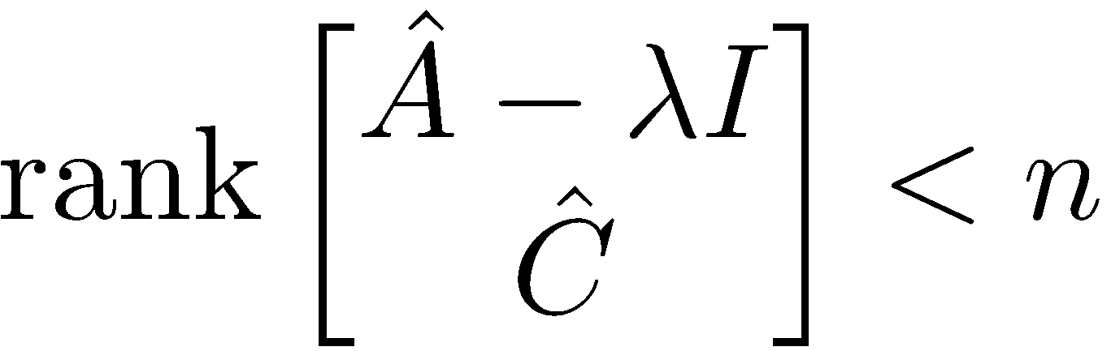


Transmission zeros
Theorem:
Let D^{T}D be invertible and define
Then is a transmission zero of the state-space realization if and only if
Unobservable mode of at

